Slide 1
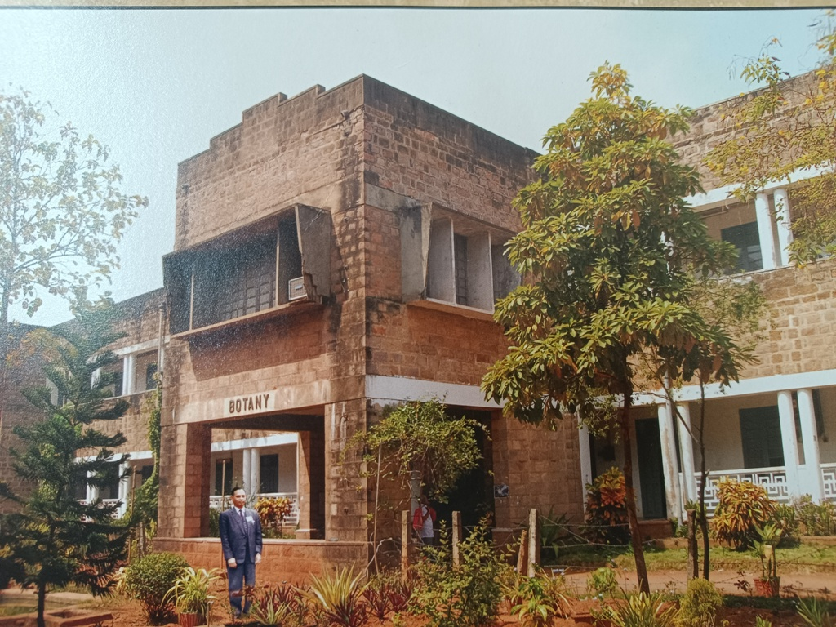
W E L C O M E
to
NATIONAL ASSESSMENT AND ACCREDITATION COUNCIL (NAAC)
PEER TEAM
Presented
By
Prof. P. K. Ratna Kumar
HEAD, Department of Botany
Andhra University
Visakhapatnam

Slide 2
VISION
To Train the students in all aspects of ecosystem, the importance of plant diversity and to provide good knowledge on sustainable ecosystem for development of a humane and just society.

Slide 3
MISSION
To empower the students in all aspects of Plant science for the global level competition by the promotion of quality of teaching, learning and research.
To undertake quality related research studies, consultancy and training programmes.
To fasten global competencies among students and to inculcate value system in them.
To promote the use of state - the art technology and quest for excellence.

Slide 4
DEPARTMENT PROFILE
The department was established in 1946
Cytogenetics has been one of the thrust areas in the research activities of the Department and identified as one of the pioneer centers in Cytogenetics .
DRS(1972-1986)--DSA(1986-2012 and CAS SAP- Phase-I In Botany.(2012-2017).
UGC has also recognized this Department and extended financial support of Rs.45.0 lakhs under COSIST ("Committee on Strengthening of Infrastructure for Science and Technology).

Slide 5
QUALITY POLICY
The Department of Botany is committed to achieve excellence in teaching, research and consultancy
By imparting globally focused education,
By creating world class professionals,
By establishing synergic relationships with industry and society,
By developing state of art infrastructure and well-endowed faculty,
By imparting knowledge through teamwork and incessant efforts.

Slide 6
Programmes Offered:
M.Sc. Botany.
Ph D. Botany.
Electives: M. Sc. Botany
Advanced Cytogenetic
Biosystematics
Applied Phycology
Crop Physiology and Biotechnology
Plant Pathology
Agricultural Biotechnology
Ethnobotany Medicinal and Aromatic Plants

Slide 7
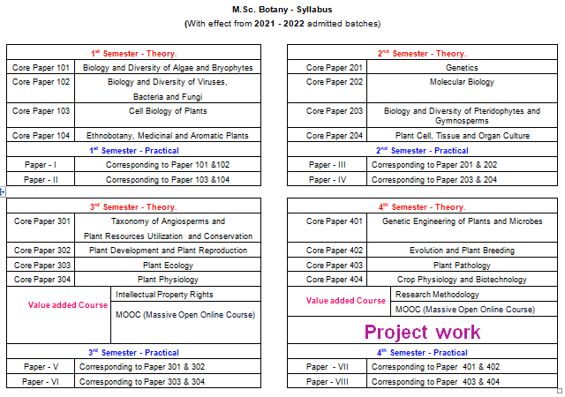

Slide 8
Physical facilities
Class rooms – 4 (Projectors & Black Board in Classrooms)
Laboratories - 9
(All basic equipment & chemicals, microscopes &
materials for class work purpose in Laboratories)
Seminar hall - 1 (Interactive TV)
Library – 1
Museum - 1

Slide 9
Herbarium – 1
(Andhra university Herbarium is recognized worldwide and listed in Index Herbarium. Code: AUV)
Reading room – 1
Ladies waiting hall – 1
Botanical Garden
(It is listed in 174-page number in Dictionary of Botanical Gardens and Parks in India, Published by BSI, Government of India in 1990)
Botany Experimental Farm at Hanumanthawaka

Slide 10
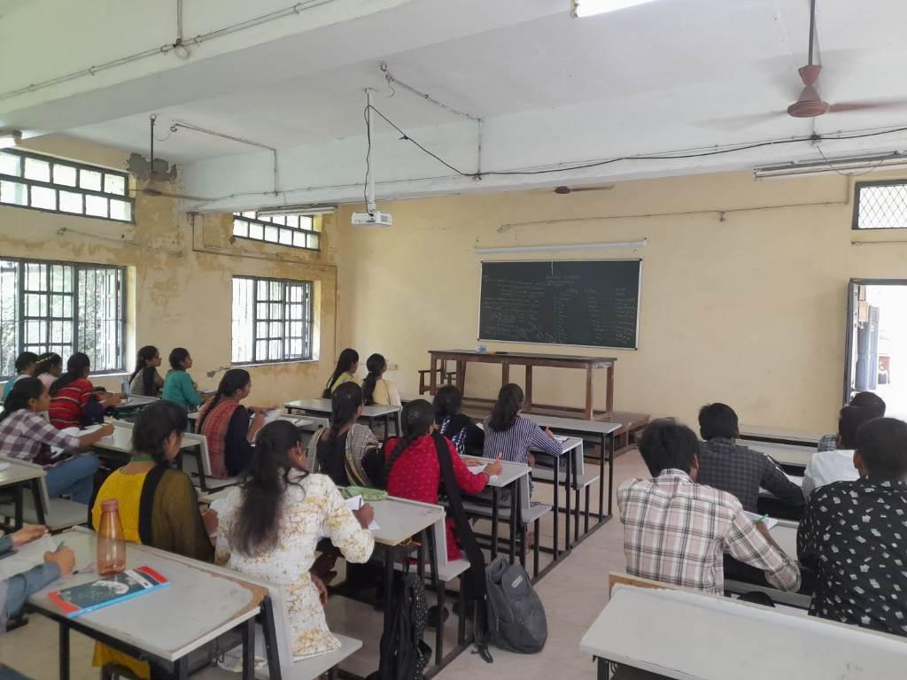
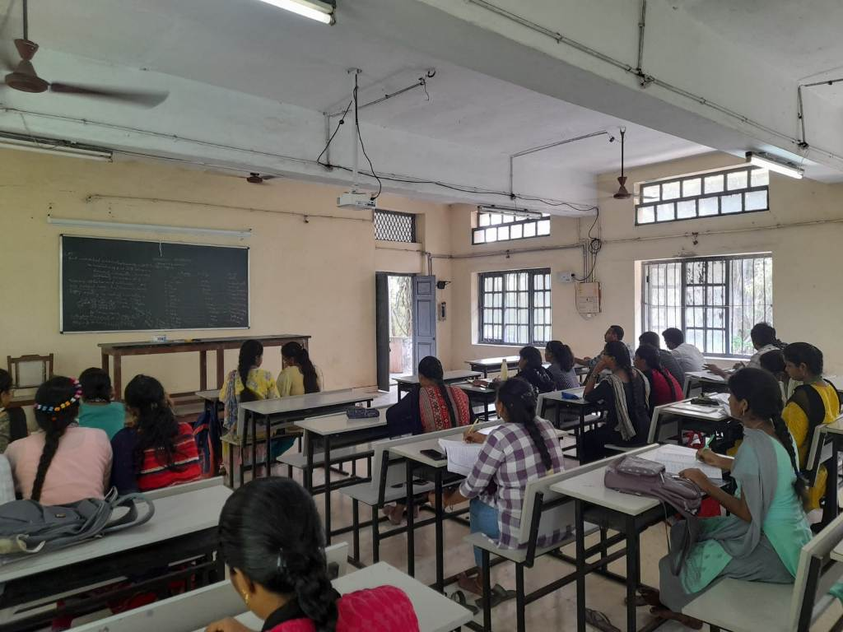
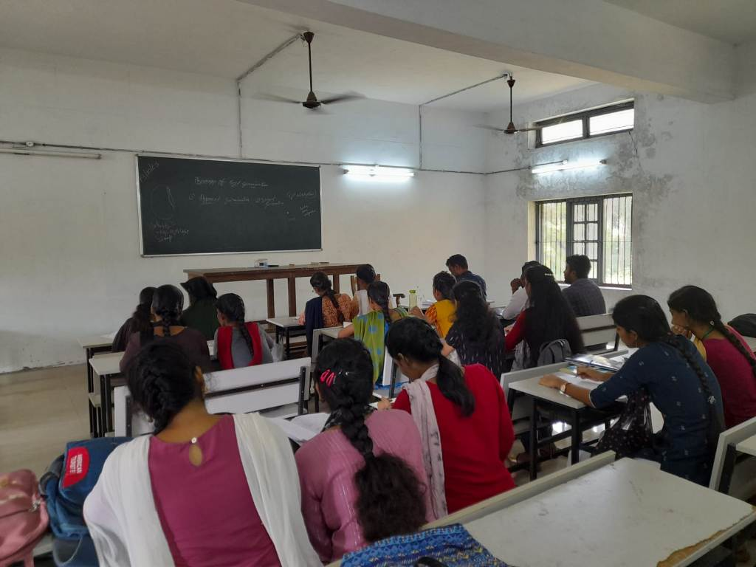
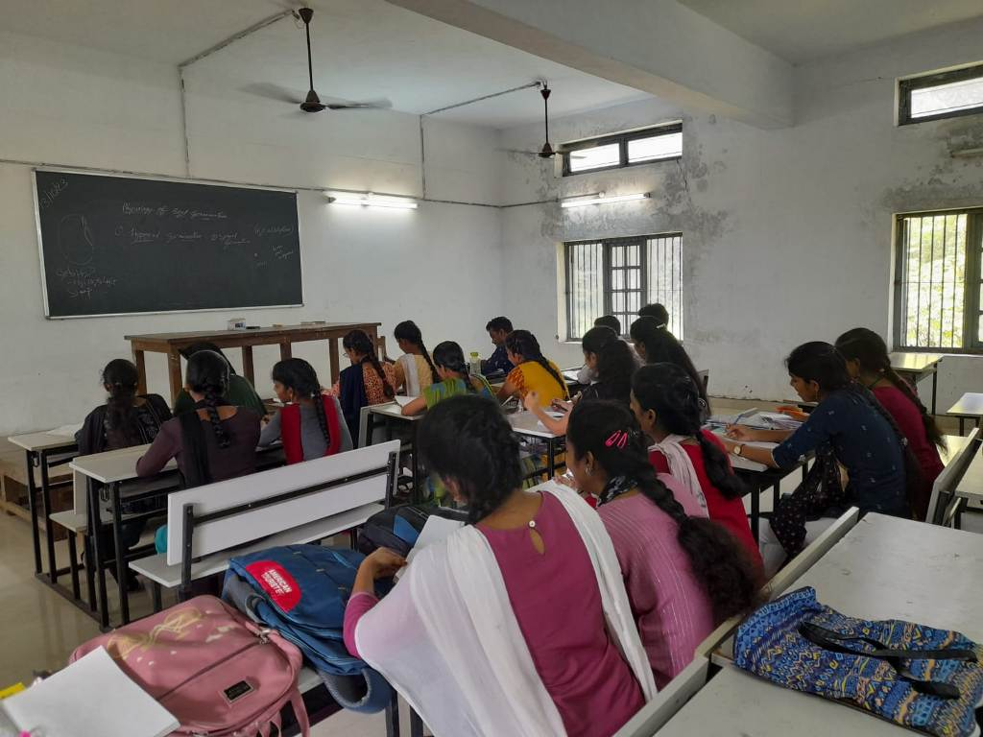
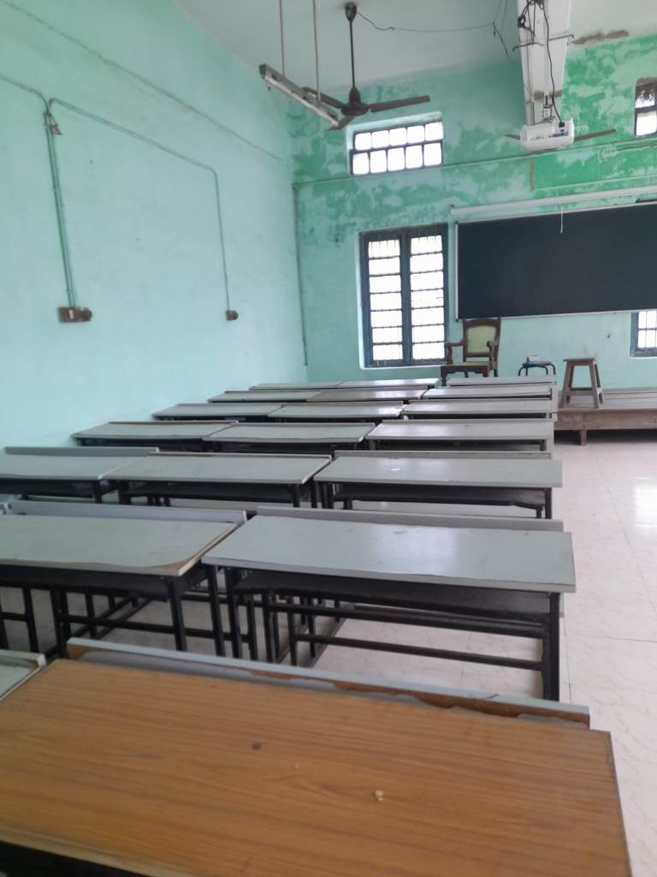
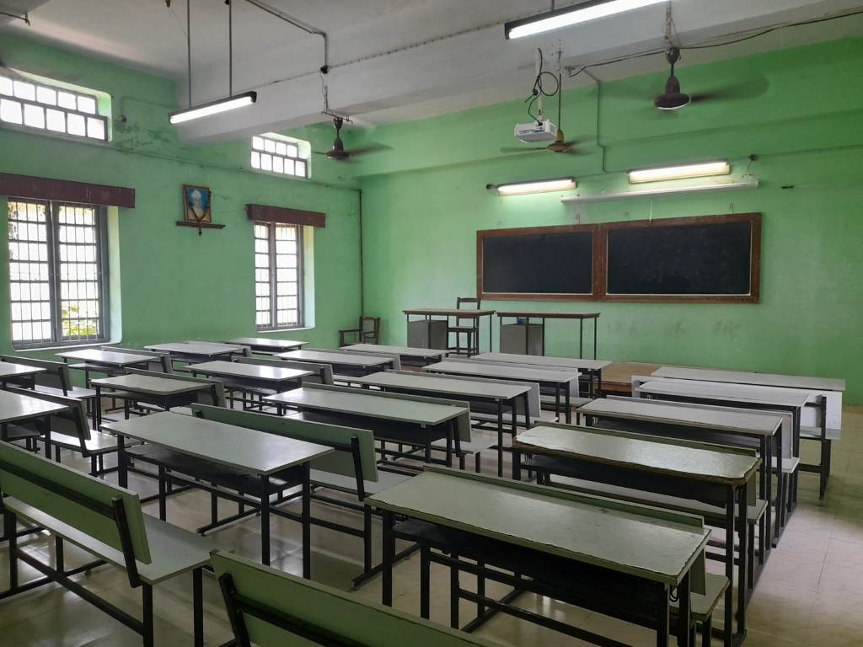
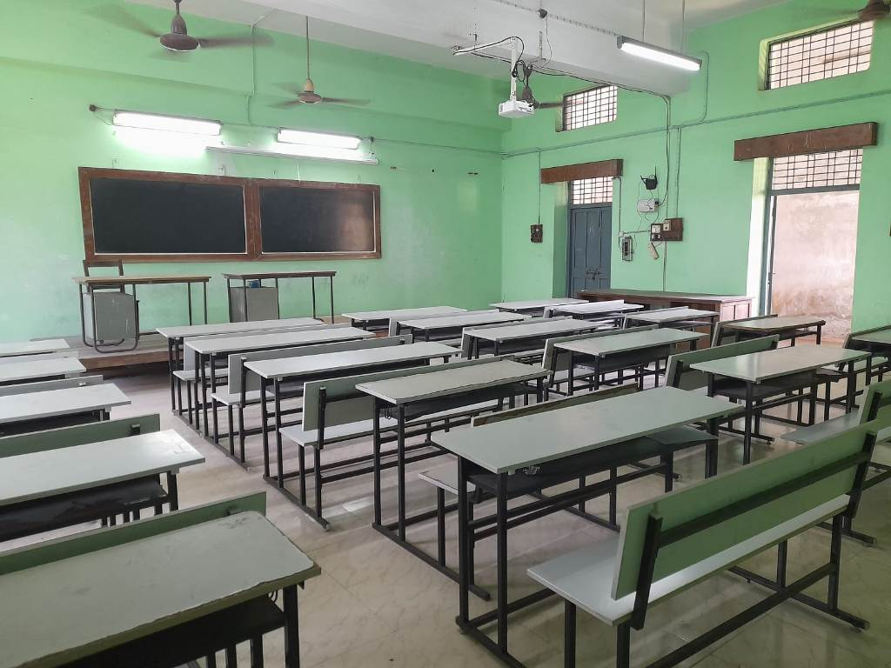
Class Rooms
Class Room no. 57
Class Room no. 65
Class Room no. 43
Class Room no. 45

Slide 11
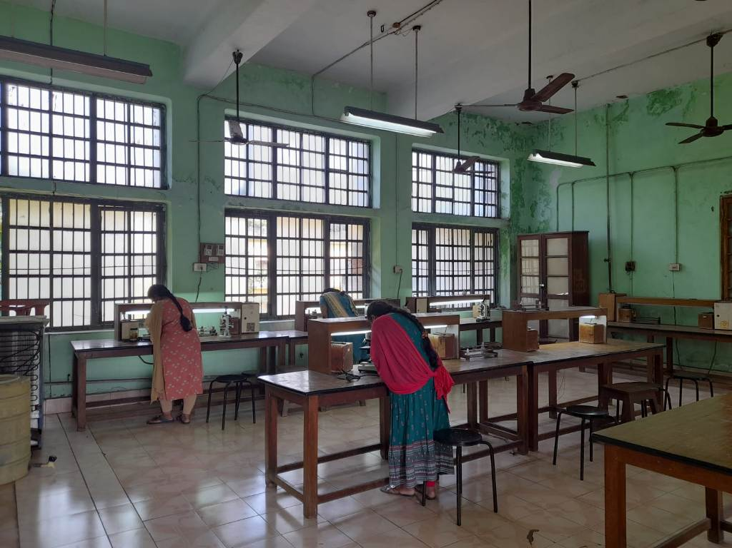
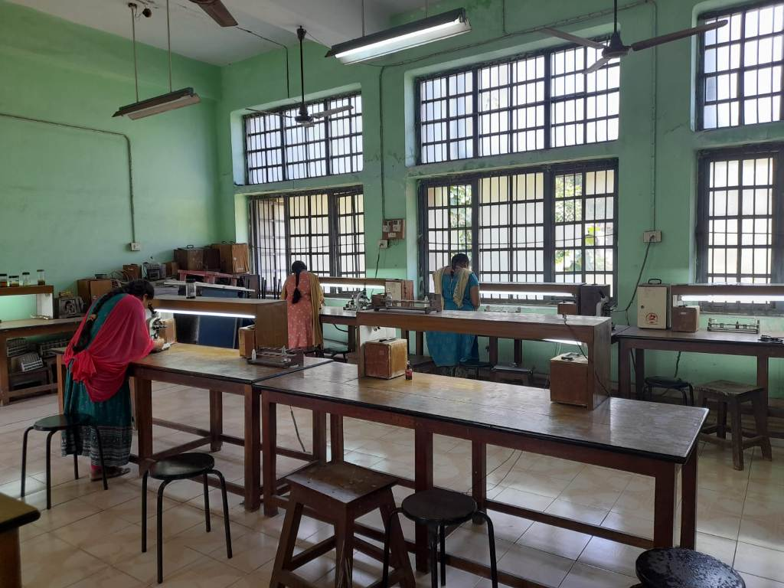
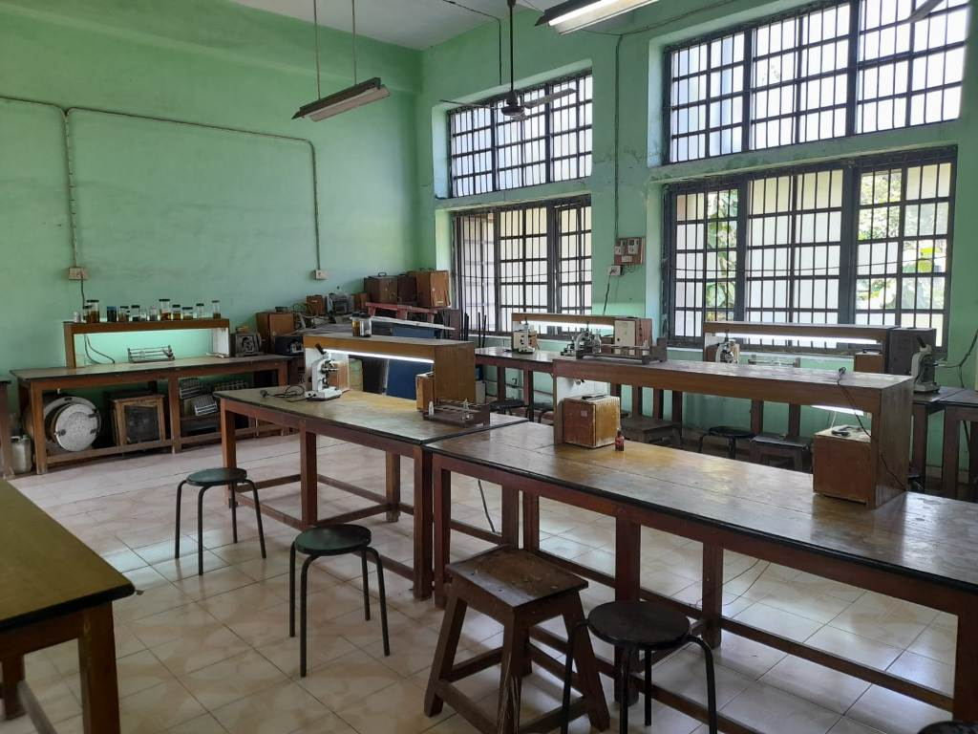
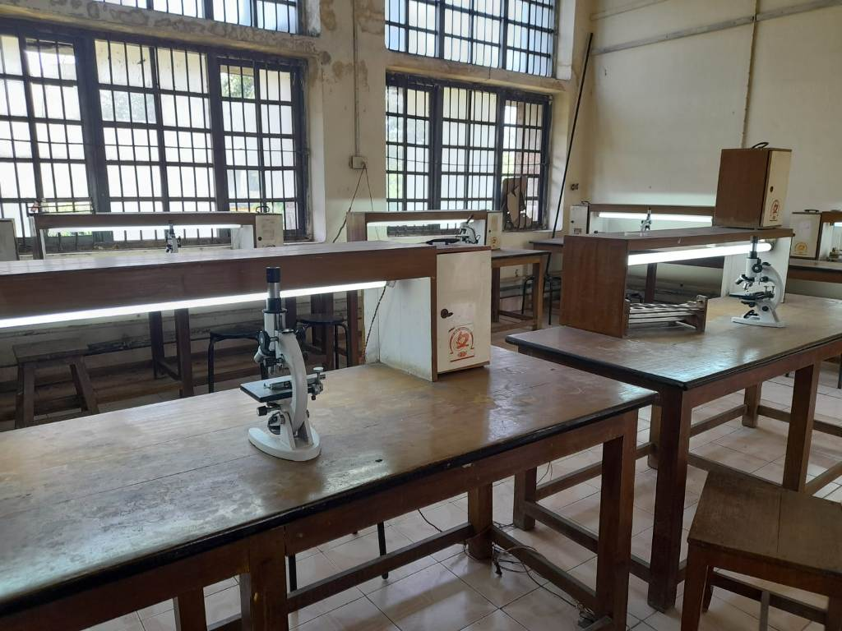
Laboratories

Slide 12
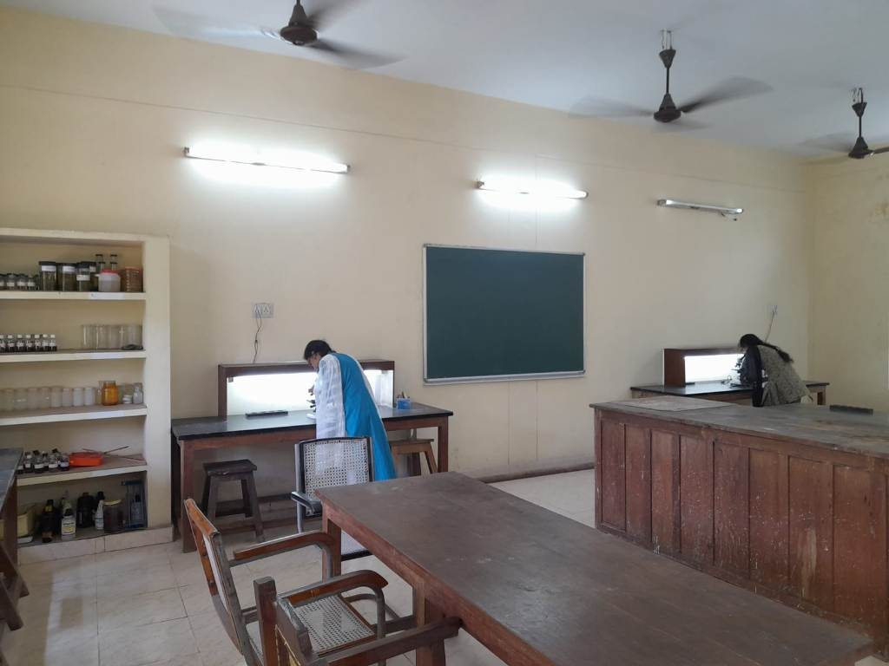
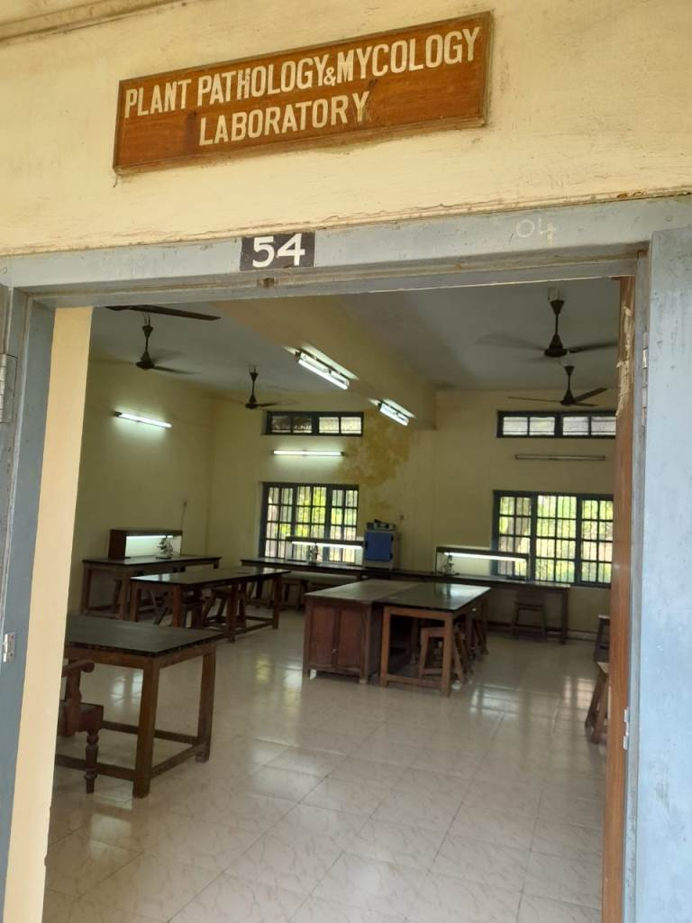
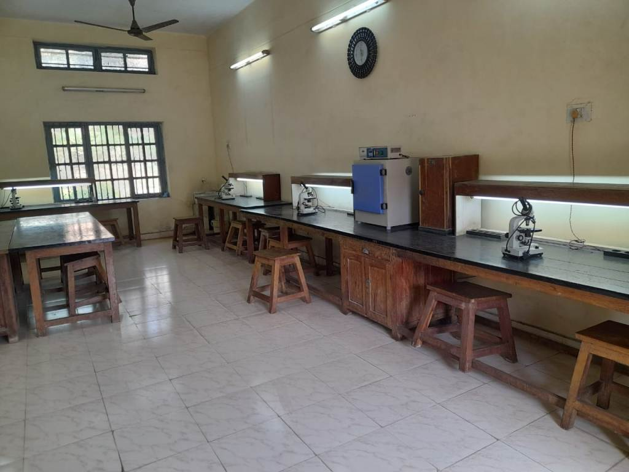
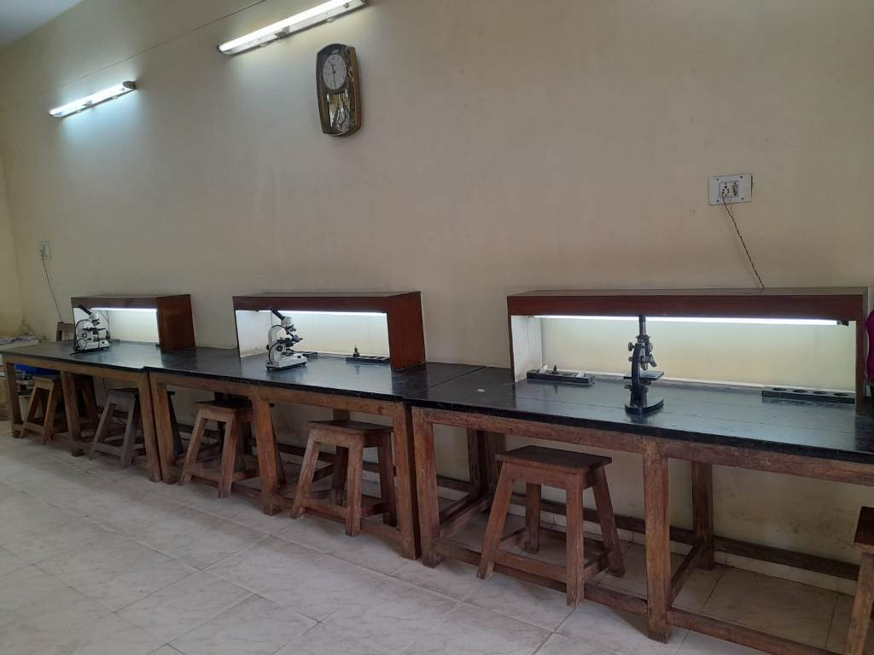
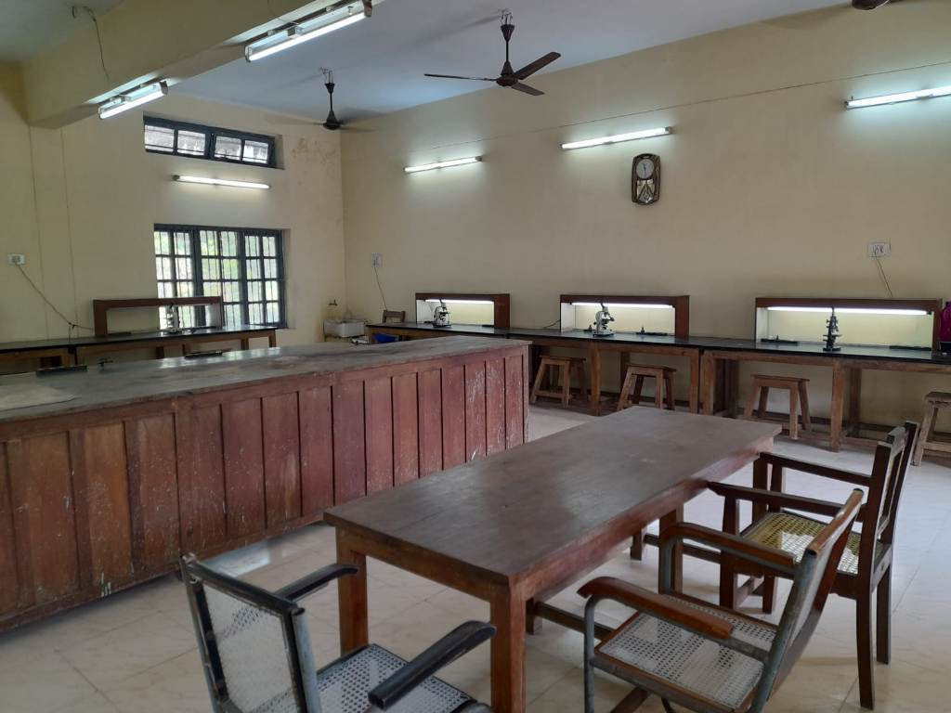
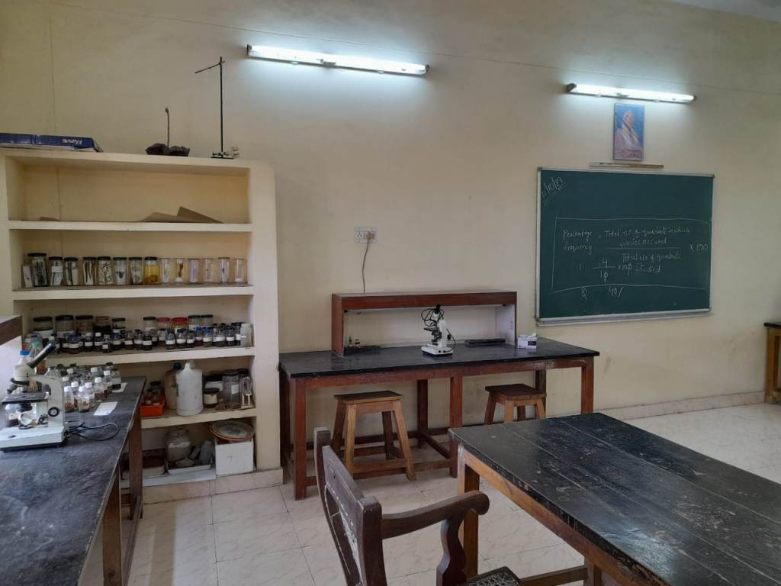
Laboratories

Slide 13
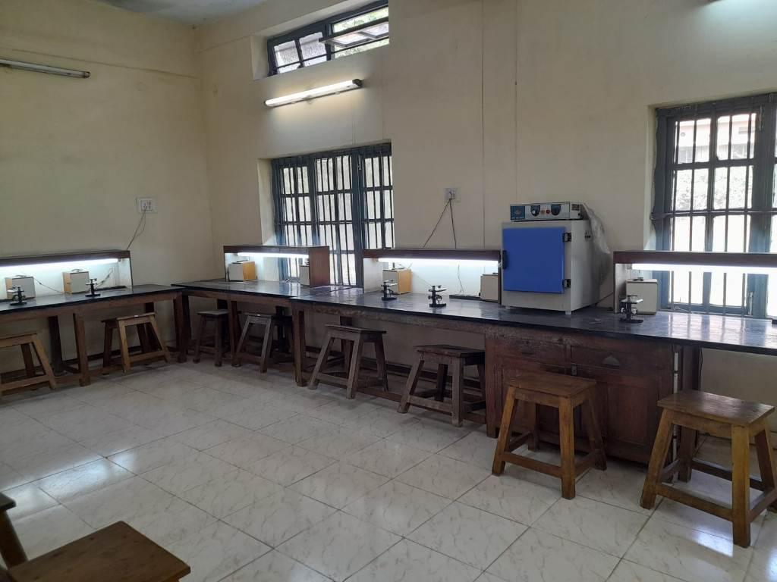
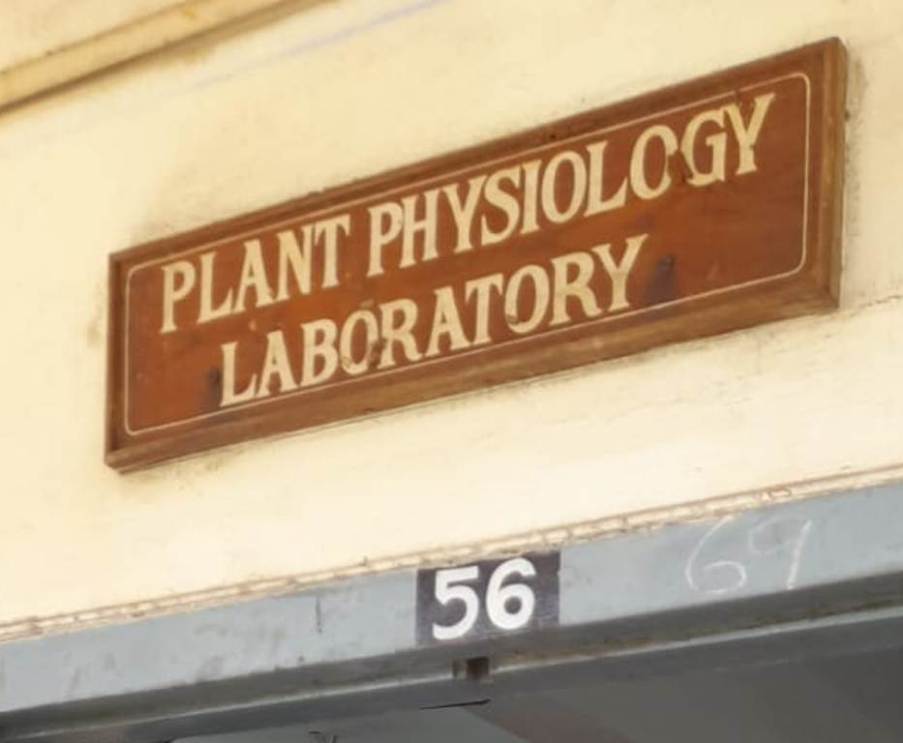
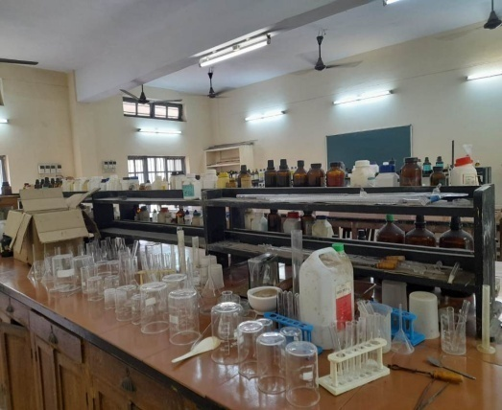
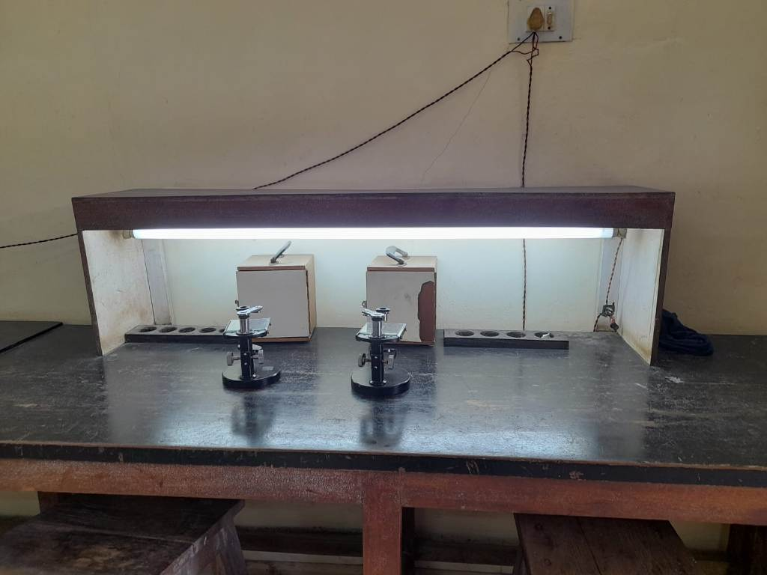
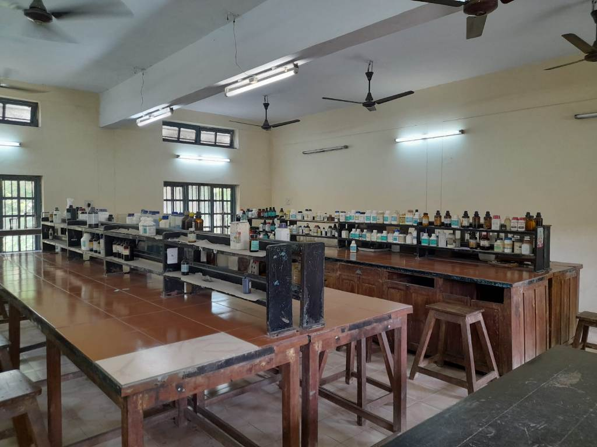
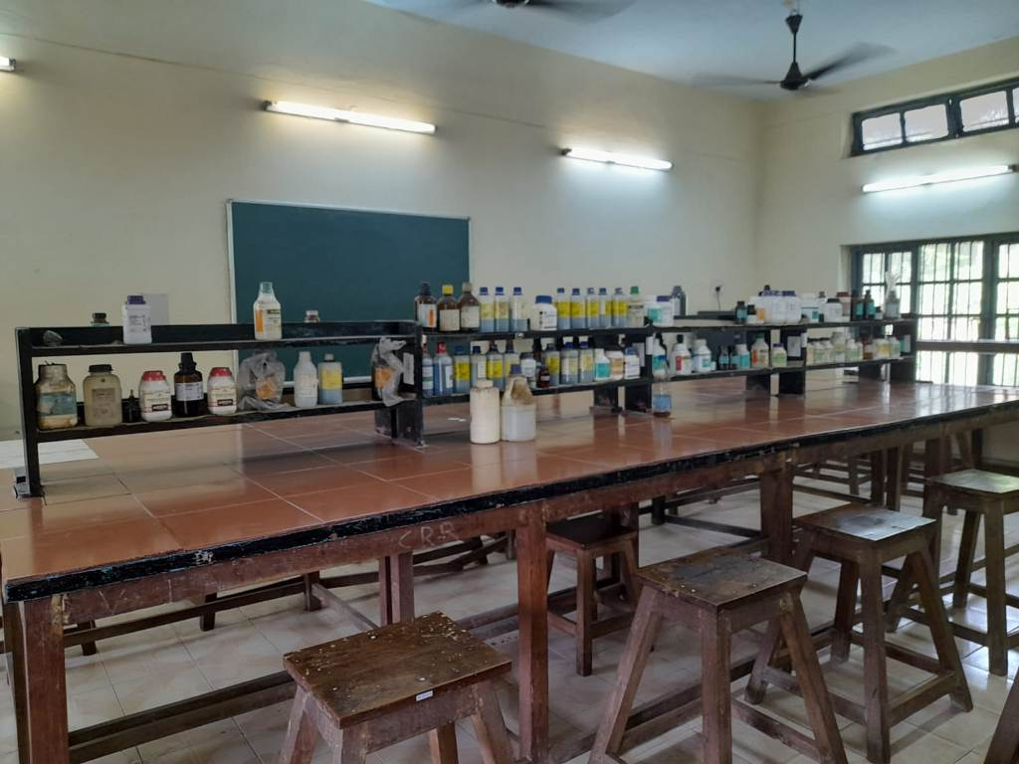
Laboratories

Slide 14
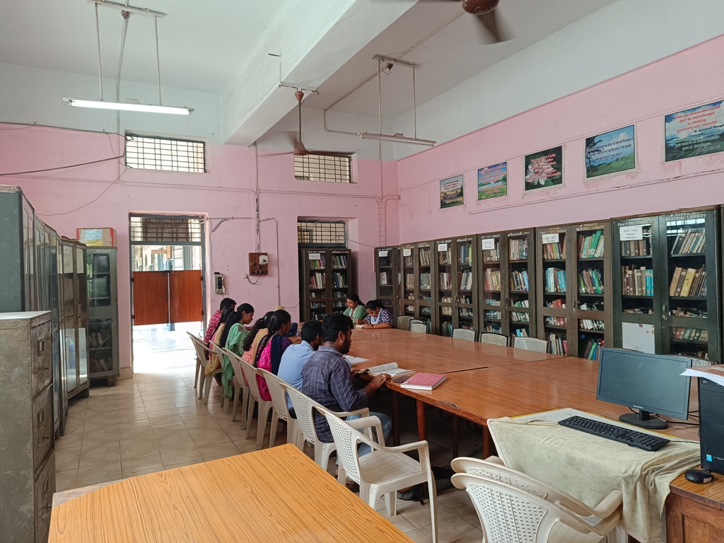
DEPARTMENT LIBRARY

Slide 15
The Department is collaborating with
National institutes like
BSI (Botanical Survey of India)
SPICES BOARD
NRSC (National Remote Sensing Centre)
ITDA (Integrated Tribal Development Agency).

Slide 16
Workshop/Seminar/Conferences/Training programmes attended:
2019 organized an International webinar in collaboration with BSI and Andhra University
FDP conducted by CCE
National conference on Biodiversity, Biotechnology and Bioinformatics innovative and Emerging trends 2019. Berhampur.
Lecture delivered in Academic Staff College , Andhra University.

Slide 17
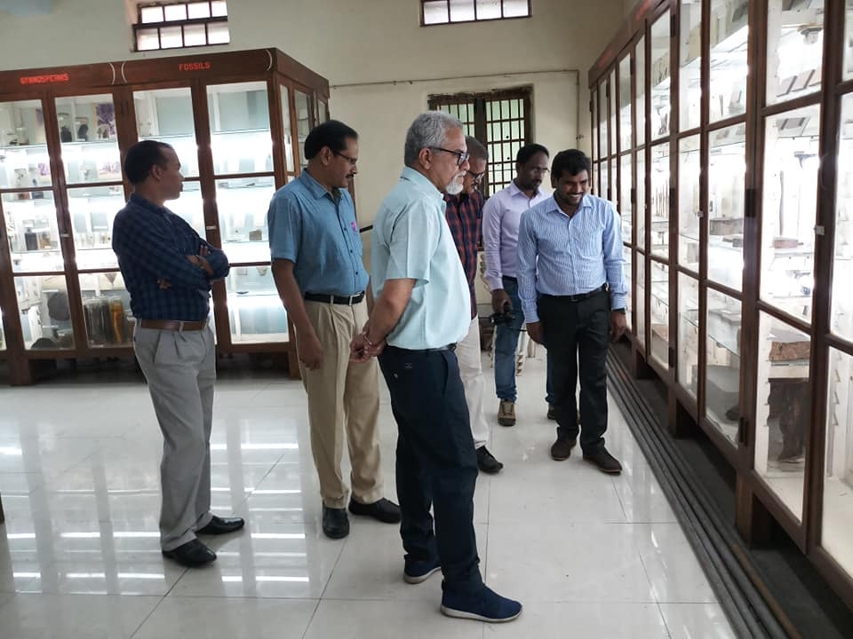
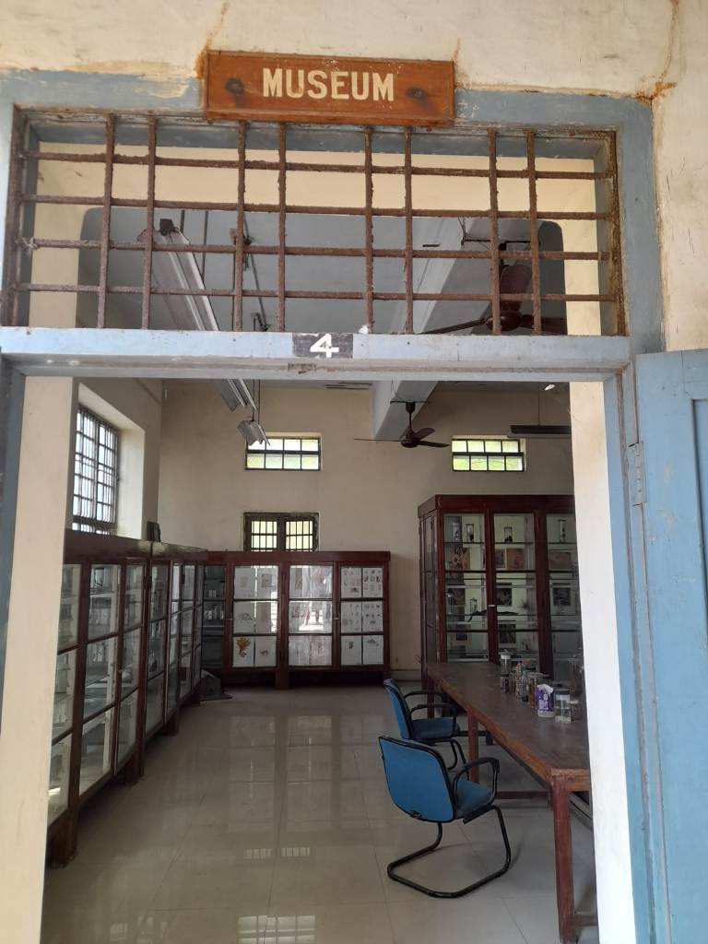
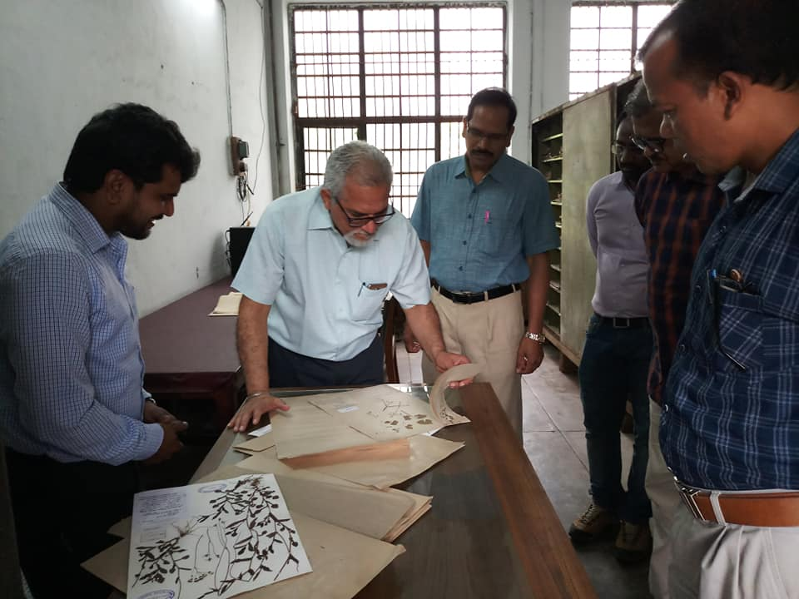
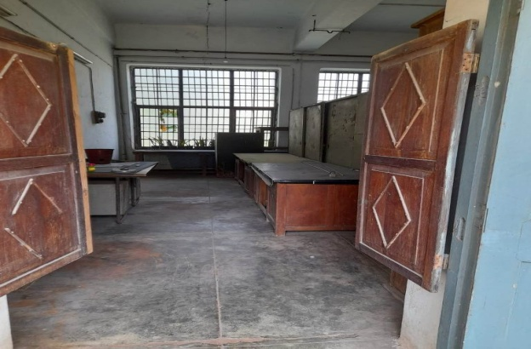
DR. PARAMJIT SINGH.
DIRECTOR, BOTANICAL SURVEY OF INDIA.
Visited: 25-08-2018

Slide 18
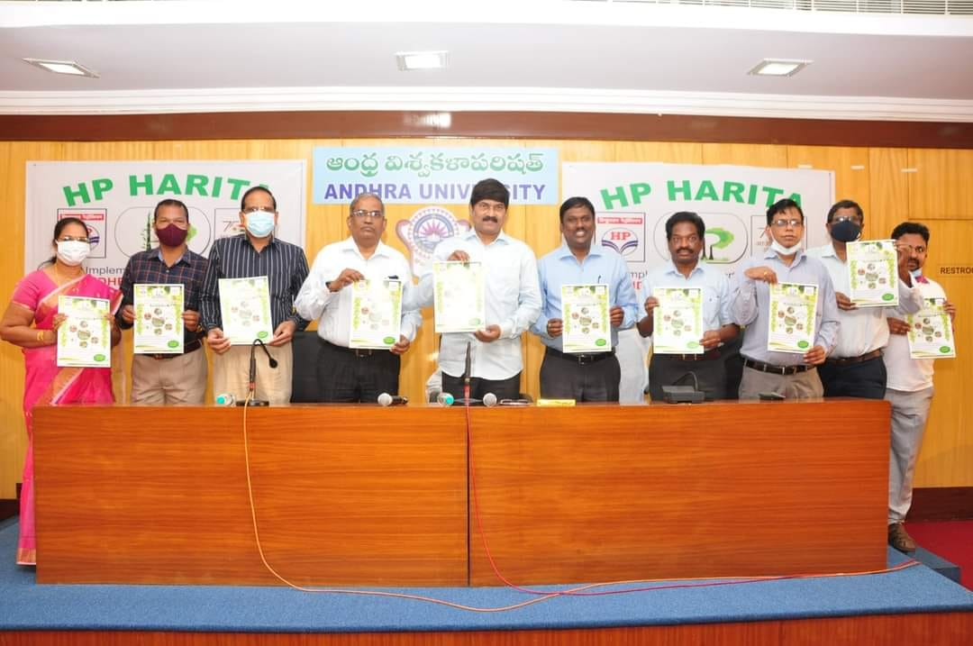
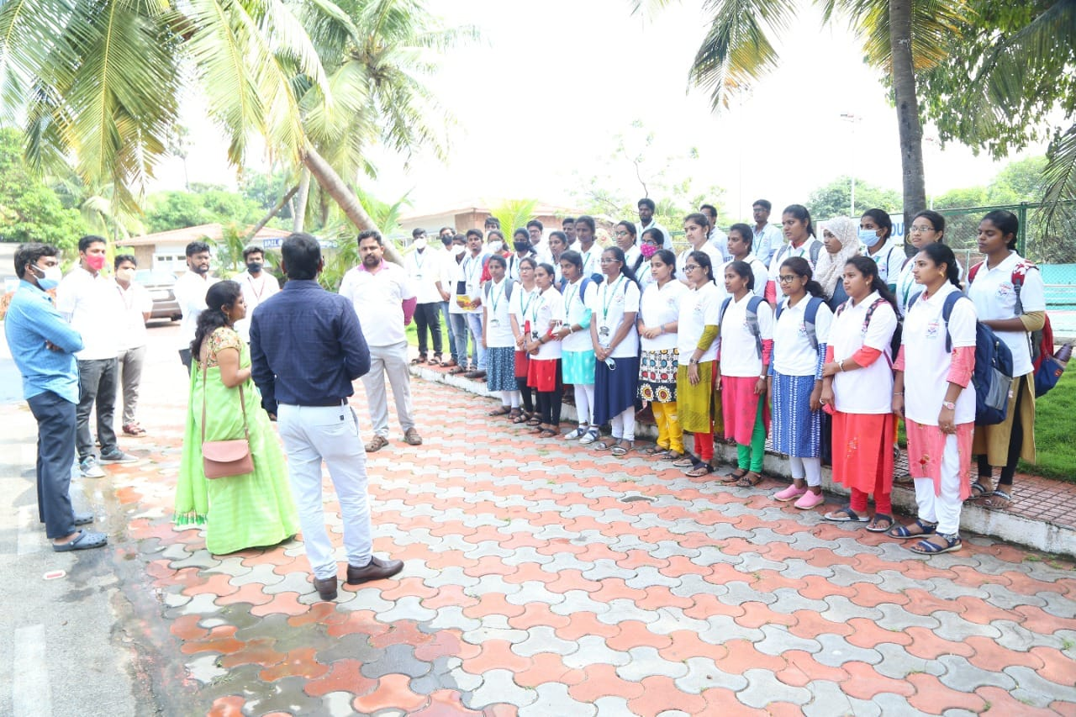
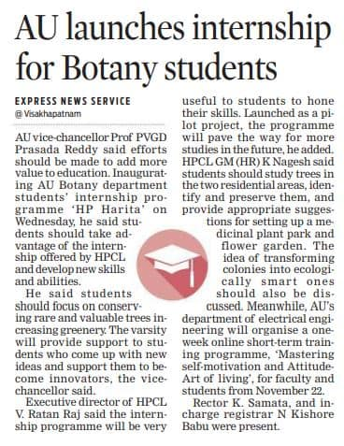
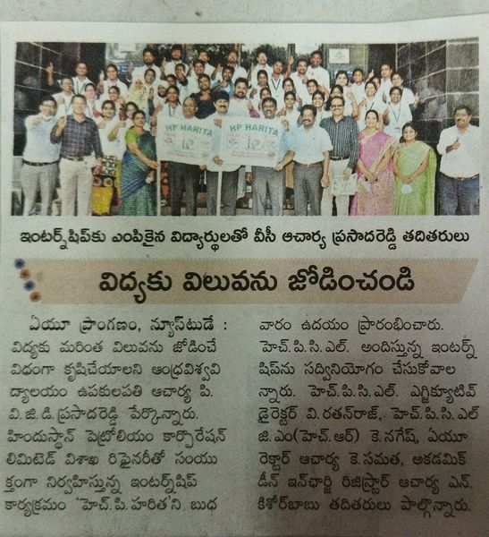
MOU Between AU Botany and HPCL, Visakhapatnam for internship 19-11-2021

Slide 19
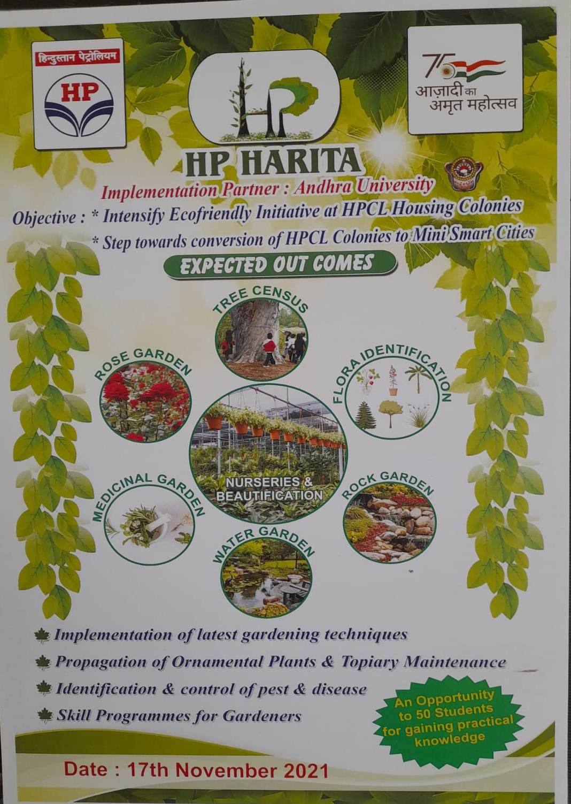
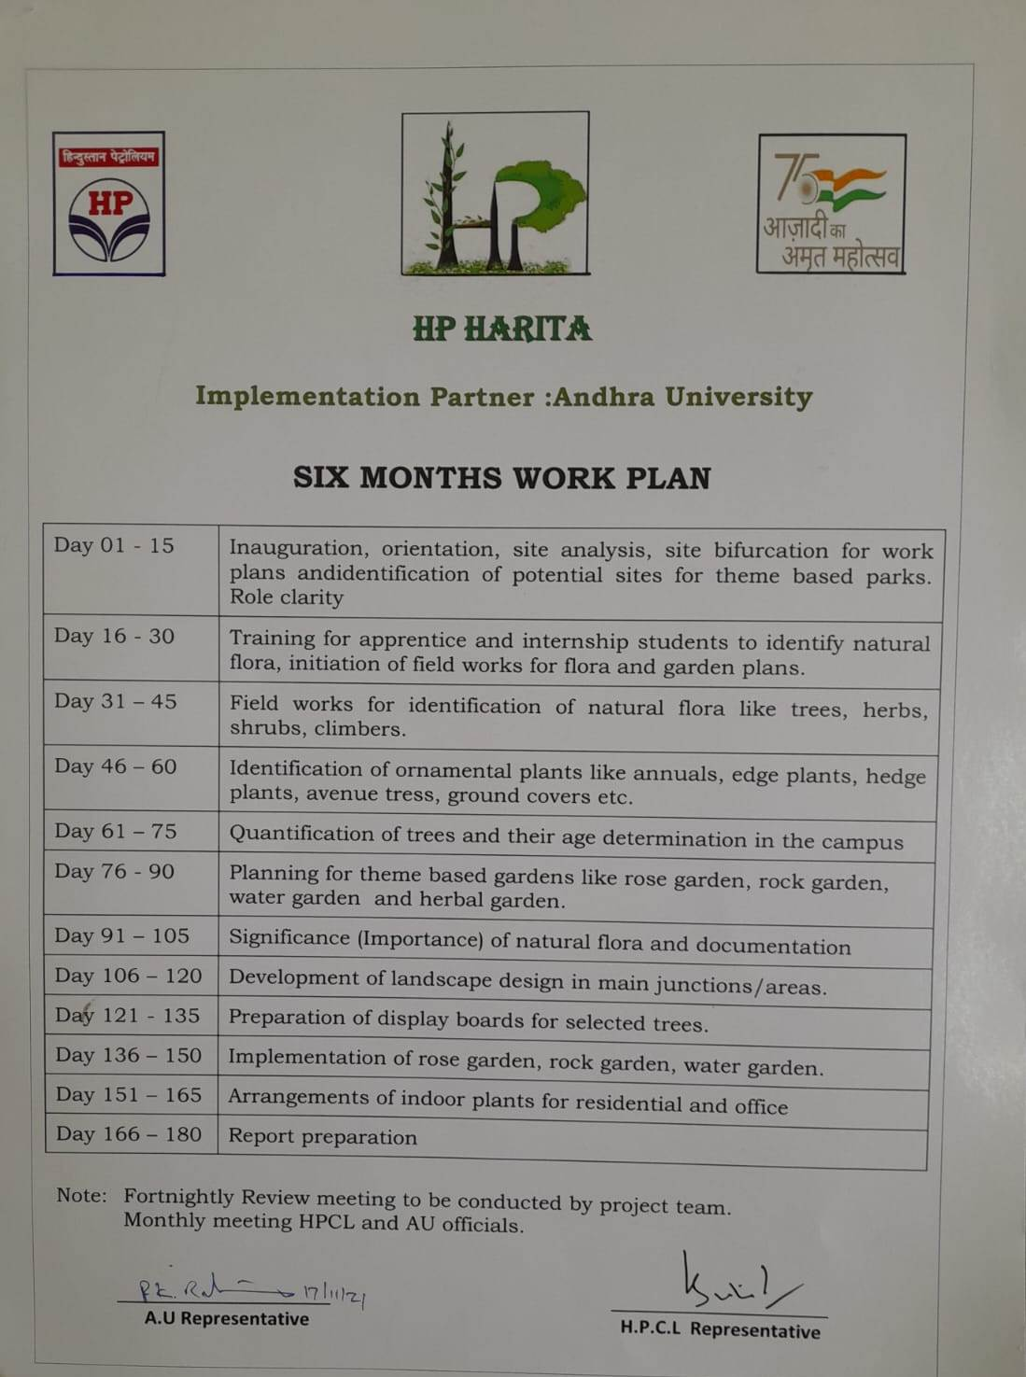
MOU - HPCL

Slide 20
FACULTY PROFILE
Name | Research area | Ph.D’s (last 5 years) | Publications | H-index | Vidwan
Prof. B. SUJATHA | Crop Physiology | 16 | 42 | 15 | 233135
Prof. P. K. RATNA KUMAR | Fungal Biotechnology | 13 | 20 | 04 | 233508
Prof. D. SANDHYA DEEPIKA | Microbiology, Mycology and Plant - Insect interactions | 15 | 33 | 07 | 23267
Prof. S.B. PADAL | Ecology and Ethnobotany | 19 | 40 | 12 | 244821
DR. P. B.S.YADAV | Plant Biotechnology | 02 | 09 | 02 | 222596
DR. B. SANDHYA SRI | Ethnobotany. | -- | 12 | 06 | 83701

Slide 21
Research Projects Completed
Name of the Investigator | Title of the project and duration | Amount sanctioned Rs. | Funding Agency
Dr. S.B. Padal | Biodiversity characterization at community level by using Earth Observing Data. | 48.10 Lakhs | DBT (2017-2021)
Prof. D. Sandhya Deepika | Development of medicinal Plant garden in HNTC, Kothavalsa, Araku valley mandal. | 29.40 Lakhs | ITDA (2018 -2021)
Teachers in administrative positions:
Prof. D. Sandhya Deepika, Asst. Principal
Prof. S. B. Padal, Dean, Horticulture &
Associate Dean of Admissions.

Slide 22
Ph.D. awarded: 50
Year | 2018 | 2019 | 2020 | 2021 | 2022
Ph.D’s | 10 | 09 | 08 | 08 | 15
Number of JRF/SRF/PDF/RA:
JRF – 10 , SRF – 10, PDF – 03
Research laboratories/others:
Each faculty having individual laboratory.
Research Facilities:
COSIST & Instrumentation

Slide 23
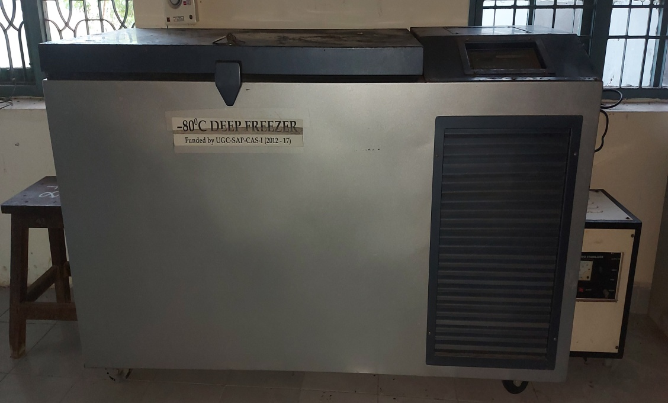
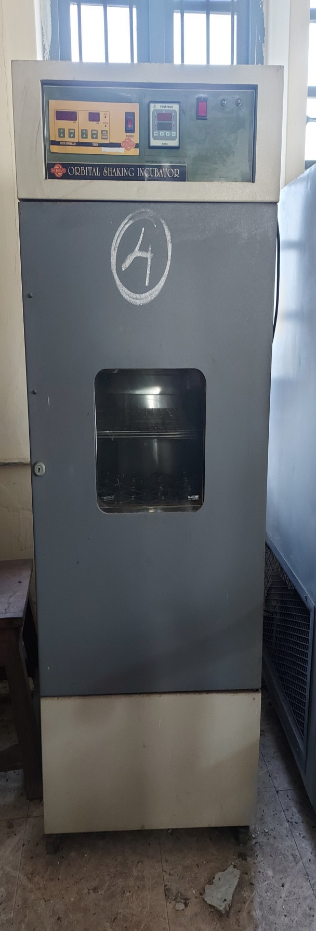
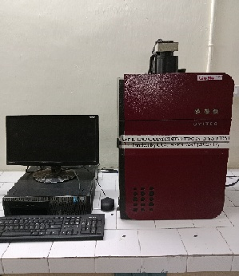
List of costly equipment :

Slide 24
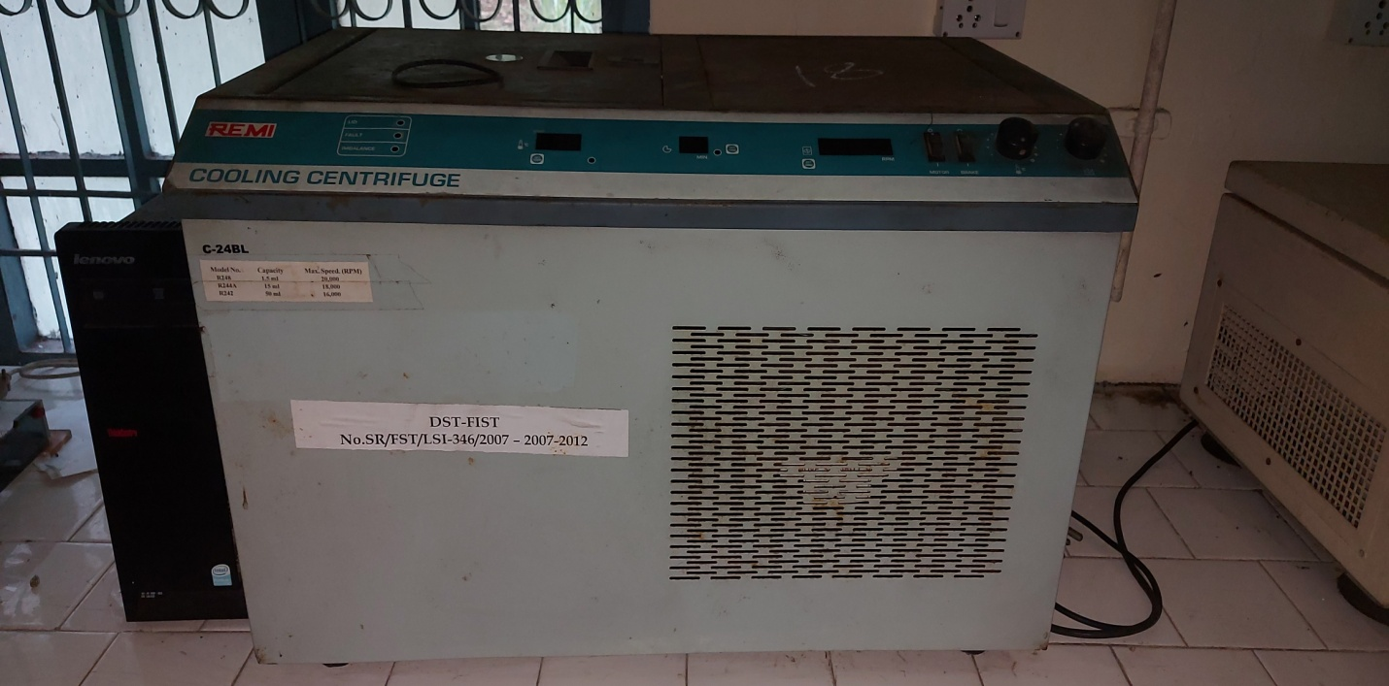
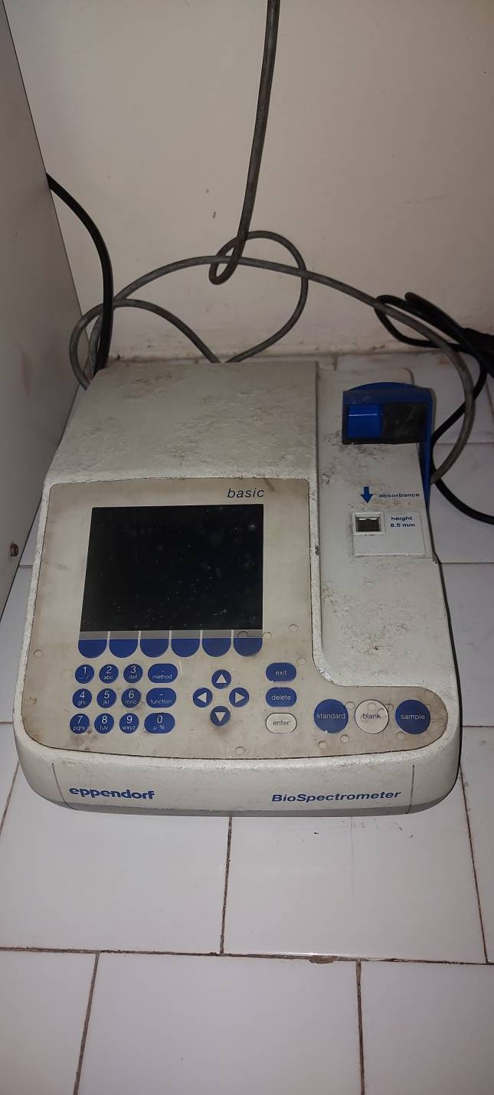
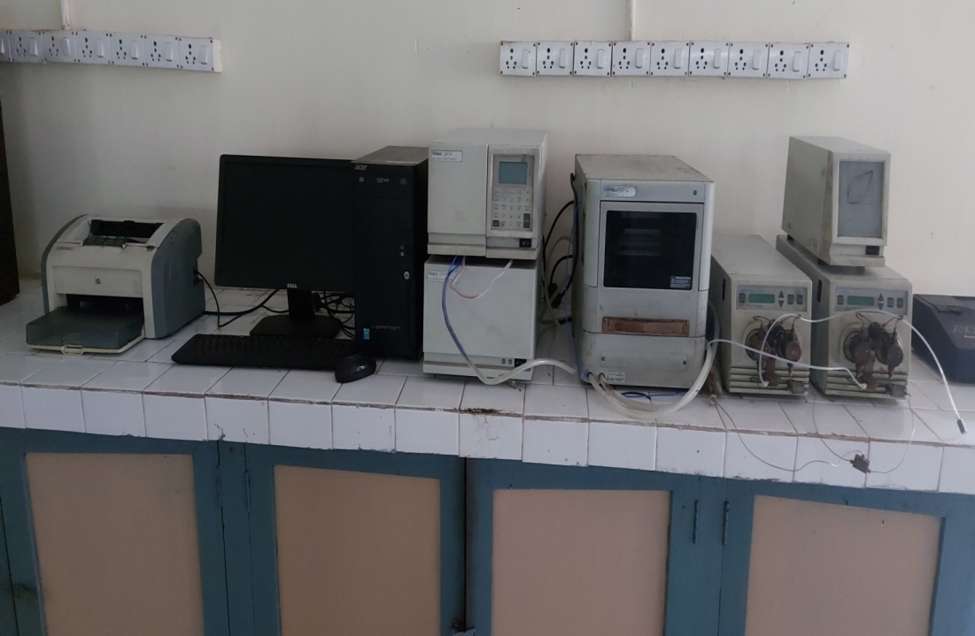
Cooling Centrifuge
HPLC

Slide 25
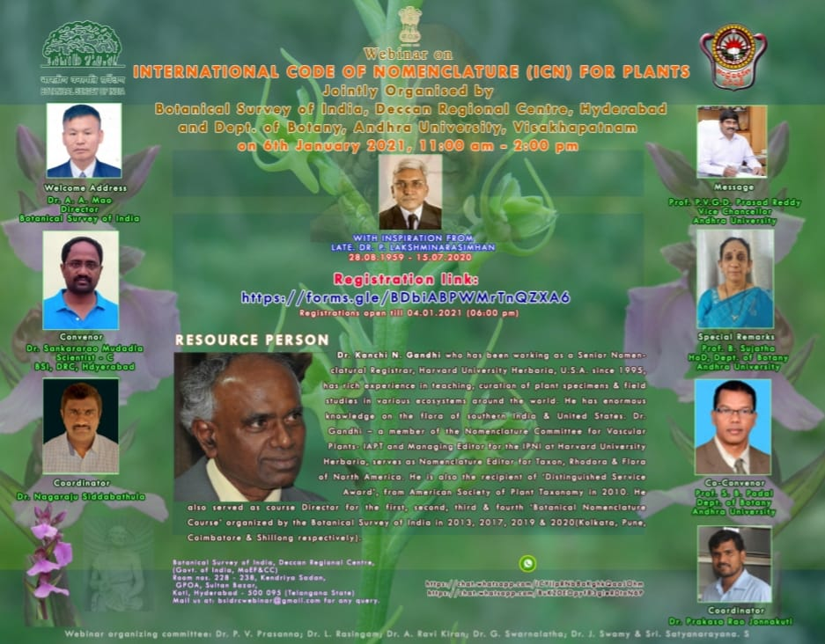
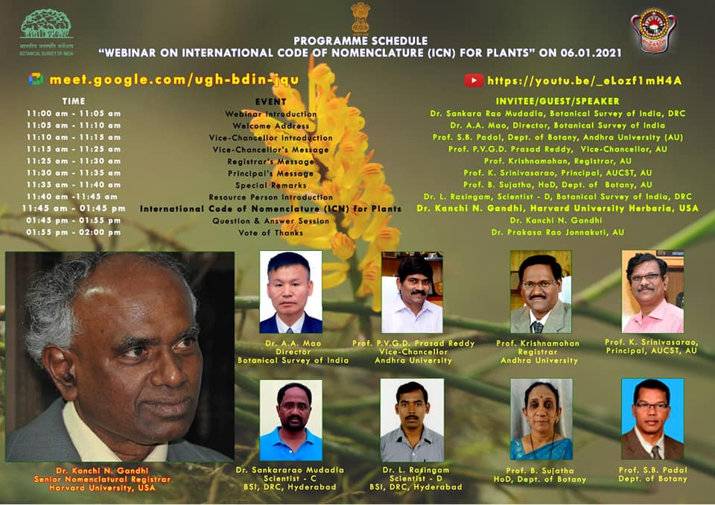
Webinar Jointly conducted on 07-01-2021 by BSI and AU entitled “International Code of Nomenclature (ICN) for Plants” Speaker: Dr.K.N.Gandhi, Harvard University Herbaria, USA
https://youtu.be/_eLozf1mH4A

Slide 26
DEMAND RATIO
Year | Botany
2017 – 18 | 01:71
2018 – 19 | 01:50
2019 – 20 | 01:38
2020 – 21 | 01:48
2021 – 22 | 01:45
STUDENT STRENGTH
Year | SC |  | ST |  | OBC |  | General |  | Total |  | Total
 | M | F | M | F | M | F | M | F | M | F | M+F
2017 – 2018 | 05 | 10 | 03 | 03 | 06 | 17 | 05 | 13 | 19 | 43 | 62
2018 - 2019 | 02 | 09 | 03 | 03 | 07 | 26 | -- | 14 | 12 | 52 | 64
2019 - 2020 | 02 | 10 | 01 | 03 | 04 | 33 | 01 | 17 | 09 | 63 | 72
2020 - 2021 | 06 | 08 | 01 | 02 | 06 | 21 | 04 | 9 | 17 | 40 | 57
2021 – 2022 | 03 | 18 | 01 | 05 | 06 | 26 | 02 | 07 | 12 | 56 | 68
2022 – 2023 | 02 | 19 | -- | 4 | 08 | 29 | 05 | 13 | 15 | 65 | 80

Slide 27
CBCS: All the papers in each Semester having
4 credits in Theory
2 credits in Practical .
4 credits for Project Work.
2 credits for MOOC’s.
1 credit for Viva-Voce.
Integration of Environmental Sustainability Human values in the Curriculum:
Awareness on protection and cultivation of – Endemic, Endangered Plant, Marine & Fresh water plant species .

Slide 28
Courses with employability / Skill development / value added programmes offered:
Seminars and Project works
Value added courses like
IPR & Research methodology.
Training on Mushroom cultivation
Tissue culture

Slide 29
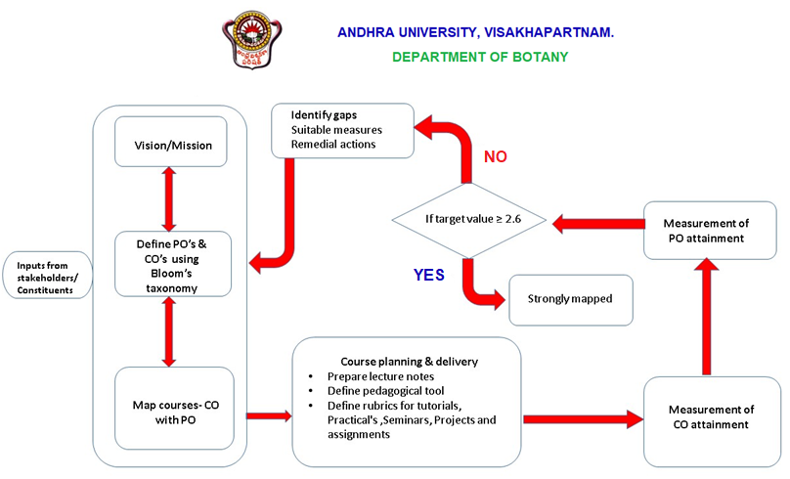
CURRICULAR ASPECTS
OBE PROGRAM STRUCTURE

Slide 30
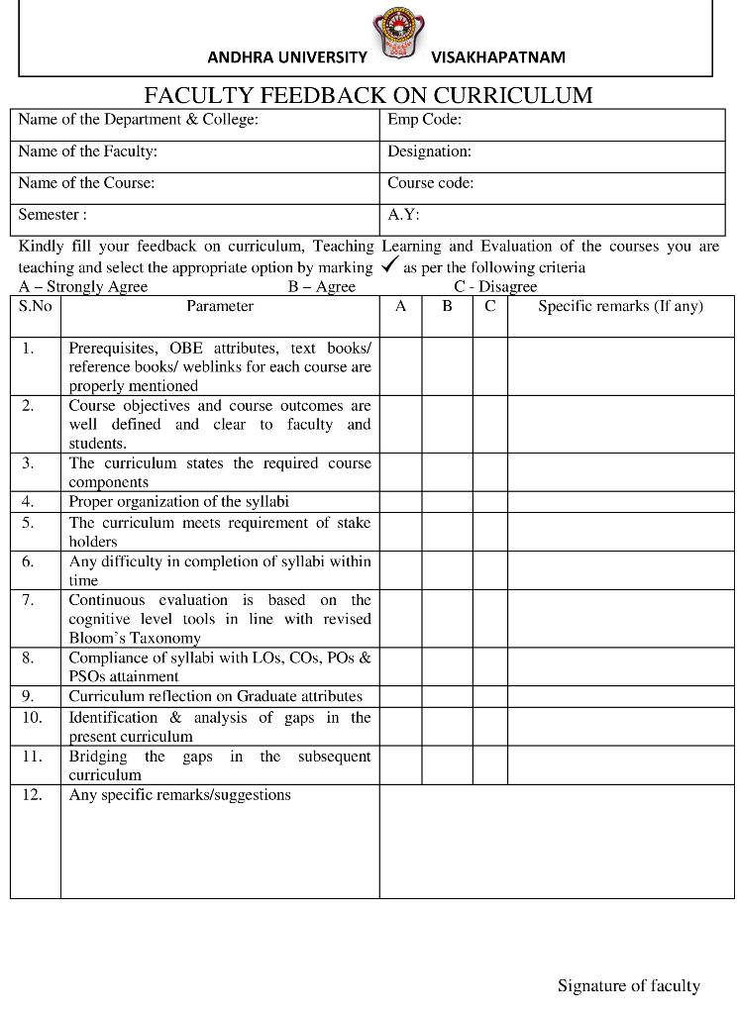
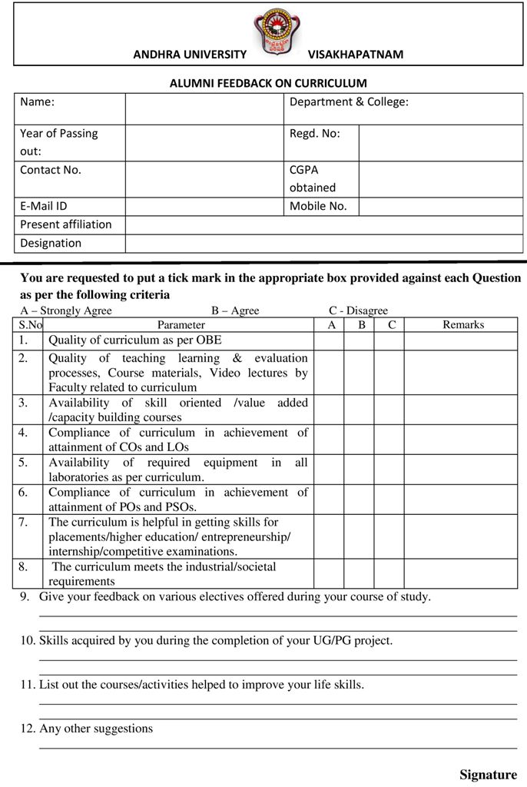
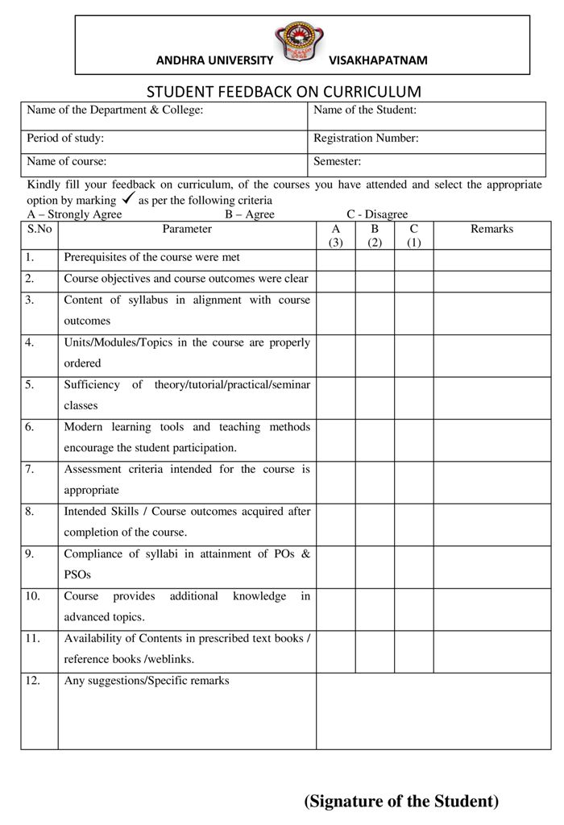
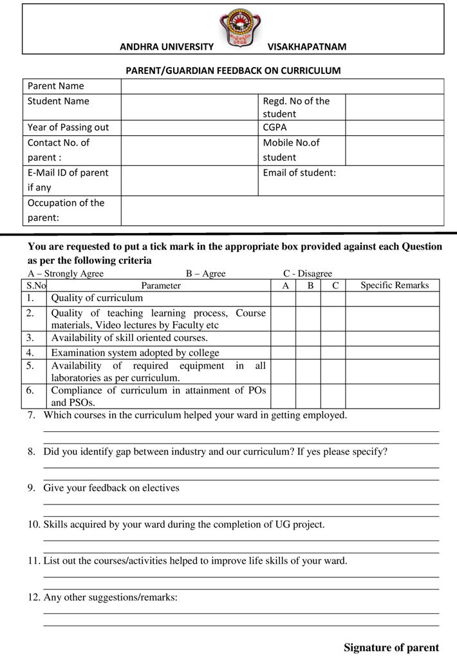
FEEDBACK FROM FACULTY, ALUMNI,STUDENTS AND PARENTS

Slide 31
ICT and online resources:
Smart/ hybrid class with smart boards and internet .
Video conferencing facility in seminar hall.
LCD projectors in all class rooms.
Mentor/Mentee System (Example of reports):
All teachers are nominated as student counselors.
Proctorial system is adopted by allotting 10 to 15 students to each teacher for counseling and guidance.
Results analysis/Pass Percentage:
Each semester, after Semester-end examinations the performance of the students was analyzed based on their CGPA. About 95% of the students are getting distinction.

Slide 32
Other facilities to student:
Departmental Garden.
Botany Experimental Farm at Hanumanthawaka
New equipment / infrastructure augmented during the assessment period:
Projectors.
Interactive TV.
Department library / e –resources / Wi-fi / internet facilities / Bandwidth / link to library e resources:
We are having Departmental Library with
more than 3000 books

Slide 33
All class rooms have speed internet facility.
New books acquired: 16 (Sixteen)
Academic Audit: Every year
Quality Audit:
All the records were verified by the team
of auditors through IQAC.
ISO Records: Maintained regularly

Slide 34
Programmes for Advanced Learners
Individual guidance for career building apart from placements in the campus
Encouraging to present papers in Journals/ Conferences/ Competitions
Guidance for CSIR NET
Competitive
Examination

Slide 35
Fortnightly Remedial classes
Programmes for Slow Learners
Assignments/ previous question papers
Individual Counseling
Improved Performance for slow learners

Slide 36
PRIZES
Pushpa Ranga Swamy Ayyenger Memorial Prize
Sri P.V.V. Seshagiri memorial Medal
Prof. J. Venkateswarlu Shastiabdipurthi Gold Medal
Smt. & Sri Veleti (Achanta) Padmavathi Devi Memorial Prize
Tallapragada Prakasa Rayudu Memorial Prize
K.G.R. Gold Medal
Prof. B.G.S. Rao Memorial Prize

Slide 37
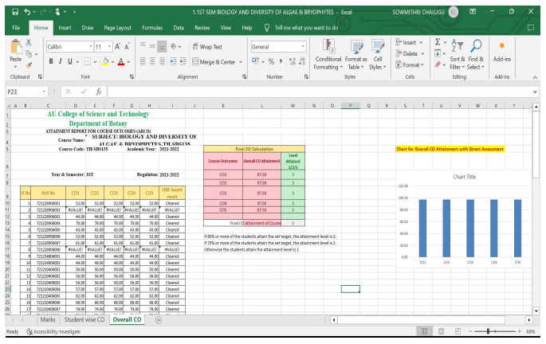
Overall CO attainment

Slide 38
PO Attainment of Programme : 2020 - 2022
PO Attainment of Programme
Academic Year |  |  | 2020-2022
Name of the Programme |  |  | : M.Sc., BOTANY
Name of the Method | PO1 | PO2 | PO3 | PO4 | PO5
 | PO Attainment Levels ( 0 to 3) (May be decimal)
BIOLOGY AND DIVERSITY OF ALGAE AND BRYOPHYTES | 2.60 | 3.00 | 2.80 | 3.00 | 2.40
BIOLOGY AND DIVERSITY OF VIRUSES BACTERIA AND FUNGI | 3.00 | 2.80 | 2.80 | 2.80 | 2.60
CELL BIOLOGY OF PLANTS | 3.00 | 3.00 | 2.00 | 2.00 | 3.00
ETHNOBOATNY,MEDICINAL AND AROMATIC PLANTS | 3.00 | 2.00 | 2.20 | 2.20 | 2.20
BIOLOGY AND DIVERSITY OF ALGAE BRYOPHYTES FUNGI BACTERIA AND VIRUSES-PRACTICAL-PR-117 | 3.00 | 2.80 | 2.80 | 2.80 | 2.40
CELL BIOLOGY,ETHNOBOTANY,MEDICINAL AND AROMATIC PLANTS- PRACTICAL -PR-A970 | 2.80 | 2.60 | 2.40 | 2.80 | 2.00
GENETICS | 3.00 | 3.00 | 2.40 | 2.00 | 3.00
MOLECULAR BIOLOGY OF PLANTS | 3.00 | 3.00 | 2.20 | 2.40 | 3.00
BIOLOGY AND DIVERSITY OF PTERIDOPHYTES AND GYMNOSPERMS | 3.00 | 2.20 | 3.00 | 3.00 | 2.20
PLANT CELL,TISSUE & ORGAN CULTURE | 3.00 | 3.00 | 2.60 | 2.60 | 2.80
GENETICS AND MOLECULAR BIOLOGY OF PLANTS-PRACTICAL-PR-119 | 3.00 | 3.00 | 2.75 | 3.00 | 3.00
BIOLOGY AND DIVERSITY OF PTERIDOPHYTES AND GYMNOSPERMS PLANT CELL, TISSUE AND ORGAN CULTURE- PRACTICAL- PR-120 | 2.80 | 2.80 | 3.00 | 3.00 | 2.20
TAXONOMY OF ANGIOSPERMS AND PLANT RESOURCES UTILIZATION AND CONSERVATION | 3.00 | 2.00 | 2.80 | 2.60 | 2.40
PLANT DEVELOPMENT AND PLANT REPRODUCTION | 3.00 | 2.40 | 2.60 | 2.60 | 2.60
PLANT ECOLOGY | 3.00 | 2.80 | 2.60 | 2.60 | 2.60
PLANT PHYSIOLOGY | 2.80 | 2.60 | 2.40 | 2.20 | 2.80
TAXONOMY OF ANGIOSPERMS AND PLANT RESOURCES UTILIZATION AND CONSERVATION AND PLANT DEVELOPMENT AND PLANT REPRODUCTION-PRACTICAL-(PR-A320) | 3.00 | 3.00 | 2.60 | 2.60 | 2.40
PLANT ECOLOGY AND PLANT PHYSIOLOGY -PRACTICAL- PR-A321 | 3.00 | 2.80 | 2.40 | 2.60 | 2.60
GENETIC ENGINEERING OF PLANTS AND MICROBES | 3.00 | 3.00 | 2.60 | 2.40 | 3.00
EVOLUATION AND PLANT BREEDING | 3.00 | 2.60 | 2.60 | 2.60 | 2.60
PLANT PATHOLOGY | 3.00 | 2.80 | 2.60 | 3.00 | 2.80
CROP PHYSIOLOGY AND BIOTECHNOLOGY | 3.00 | 3.00 | 3.00 | 3.00 | 3.00
GENETIC ENGEENIRING OF PLANT AND MICROBES AND PLANT BREEDING -PRACTICAL-(PR-A472) | 3.00 | 2.80 | 2.60 | 2.80 | 2.80
PLANT PATHOLOGY AND CROP PHYSIOLOGY AND BIOTECHNOLOGY- PRACTICAL-(PR-A473) | 3.00 | 2.80 | 2.60 | 2.40 | 3.00
PO Attainment Level (Average PO Attainment of Program) | 2.96 | 2.74 | 2.60 | 2.63 | 2.64

Slide 39
PO Attainment of Programme : 2021 - 2023
PO Attainment of Programme
Academic Year |  |  | 2021-2023
Name of the Programme |  |  | : M.Sc., BOTANY
Name of the Method | PO1 | PO2 | PO3 | PO4 | PO5
 | PO Attainment Levels ( 0 to 3) (May be decimal)
BIOLOGY AND DIVERSITY OF ALGAE AND BRYOPHYTES | 2.60 | 3.00 | 2.80 | 3.00 | 2.40
BIOLOGY AND DIVERSITY OF VIRUSES BACTERIA AND FUNGI | 3.00 | 2.80 | 2.80 | 2.80 | 2.60
CELL BIOLOGY OF PLANTS | 3.00 | 3.00 | 2.80 | 2.80 | 3.00
ETHNOBOTANY MEDICINAL AND AROMATIC PLANTS | 3.00 | 2.40 | 2.80 | 2.80 | 2.80
BIOLOGY AND DIVERSITY OF ALGAE BRYOPHYTES FUNGI BACTERIA AND VIRUSES-PRACTICAL-PR-117 | 3.00 | 2.80 | 2.80 | 2.80 | 2.40
CELL BIOLOGY,ETHNOBOTANY,MEDICINAL AND AROMATIC PLANTS- PRACTICAL -PR-A970 | 2.80 | 2.40 | 2.60 | 2.80 | 2.00
GENETICS | 3.00 | 3.00 | 2.80 | 2.80 | 3.00
MOLECULAR BIOLOGY OF PLANTS | 3.00 | 3.00 | 2.80 | 3.00 | 3.00
BIOLOGY AND DIVERSITY OF PTERIDOPHYTES AND GYMNOSPERMS | 3.00 | 2.60 | 3.00 | 3.00 | 3.00
PLANT CELL,TISSUE & ORGAN CULTURE | 3.00 | 3.00 | 2.80 | 2.60 | 2.80
GENETICS AND MOLECULAR BIOLOGY OF PLANTS-PRACTICAL-PR-119 | 3.00 | 3.00 | 2.75 | 3.00 | 3.00
BIOLOGY AND DIVERSITY OF PTERIDOPHYTES AND GYMNOSPERMS PLANT CELL, TISSUE AND ORGAN CULTURE- PRACTICAL- PR-120 | 2.80 | 2.80 | 3.00 | 3.00 | 3.00
TAXONOMY OF ANGIOSPERMS AND PLANT RESOURCES UTILIZATION AND CONSERVATION | 3.00 | 2.60 | 2.80 | 2.60 | 3.00
PLANT DEVELOPMENT AND PLANT REPRODUCTION | 3.00 | 2.40 | 2.80 | 2.60 | 2.60
PLANT ECOLOGY | 3.00 | 2.80 | 2.80 | 2.60 | 2.60
PLANT PHYSIOLOGY | 2.80 | 2.60 | 3.00 | 3.00 | 2.80
TAXONOMY OF ANGIOSPERMS AND PLANT RESOURCES UTILIZATION AND CONSERVATION AND PLANT DEVELOPMENT AND PLANT REPRODUCTION-PRACTICAL-(PR-A320) | 3.00 | 3.00 | 2.80 | 2.60 | 3.00
PLANT ECOLOGY AND PLANT PHYSIOLOGY -PRACTICAL- PR-A321 | 3.00 | 2.80 | 2.80 | 2.60 | 2.60
GENETIC ENGINEERING OF PLANTS AND MICROBES | 3.00 | 3.00 | 2.60 | 3.00 | 3.00
EVOLUATION AND PLANT BREEDING | 3.00 | 2.60 | 2.60 | 2.60 | 2.60
PLANT PATHOLOGY | 3.00 | 2.80 | 2.60 | 3.00 | 2.80
CROP PHYSIOLOGY AND BIOTECHNOLOGY | 3.00 | 3.00 | 3.00 | 3.00 | 3.00
GENETIC ENGEENIRING OF PLANT AND MICROBES AND PLANT BREEDING -PRACTICAL-(PR-A472) | 3.00 | 2.80 | 2.60 | 2.80 | 2.80
PLANT PATHOLOGY AND CROP PHYSIOLOGY AND BIOTECHNOLOGY- PRACTICAL-(PR-A473) | 3.00 | 2.80 | 2.60 | 2.40 | 3.00
PO Attainment Level (Average PO Attainment of Program) | 2.96 | 2.79 | 2.78 | 2.80 | 2.78

Slide 40
Placements:
Around 80% students got placements in Public & Private sectors
Akash.
Bashyam.
Pulsus.
Sri Prakash.
Sri Chaitanya.
Aditya Junior College.
KKR Gowtham.
Academic Audit: Every year
Quality Audit:
All the records were verified by the team of auditors through IQAC.
ISO Records: Maintained regularly

Slide 41
Placements

Slide 42
Plantation Programmes News item about department in AU Looks (03-04-2023)

Slide 43
BOTANY GARDEN
Nature Science Foundation, Tamil Nadu team visit to AU campus for green audit (15-10-2022)

Slide 44
Andhra University
BOTANY EXPERIMENTAL FARM
Hanumantawaka

Slide 45
Prof. H. Y. Mohan Ram
Department of Botany,
University of Delhi
Raju Kucherlapati
Paul C. Cabot Professor of Genetics
Professor of Medicine, Harvard Medical School
Boston, MA 02115, USA
Raju Chaganti
Memorial Sloan-Kettering Cancer Centre
1275 York Avenue
New Delhi, NY 10021, USA
Ramana Tantravahi, Ph.D.
Director, Cytogenetics Laboratory
Dana-farber Cancer Institute
Associate Professor, Department of Medicine, Harvard Medical School, Boston, ma, USA
Cherla B Sastry, Ph.D.
Professor Adjunct of Forestry, University of Toronto, ED, C&R Associates, Toronto, Canada

Slide 46
No. of Students settled in Civil Services, various academic, private and public undertakings / Institutions and Banks
IAS: Vijaya Kumar, Dwaraka Rani, T. Chandrashaker
IPS: Ranga Rao, Aniel Kumar
IRS: Madhusudhan Reddy
IFS: Lohithayushudu, Subhakar Rao, Satish, Jyohar Babu, Bharath Kumar, Jyothi, Néeraja, Balakrishna Reddy

Slide 47
Future Plans:
Focus on interdisciplinary research collaboration.
To study Plant Sciences at molecular level.
To encourage the research scholars and faculty to pursue contemporary research problems which are useful to the society.

Slide 48
THANK YOU

